Slide 1
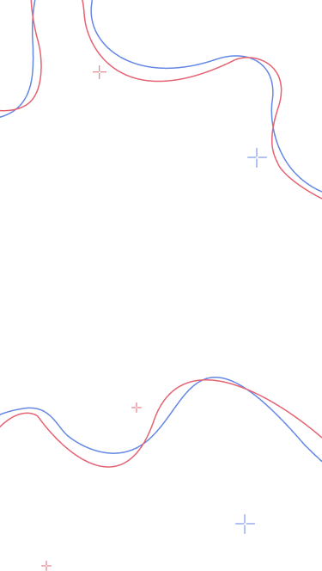




exploreSG
discover new places and invite your friends to go together, with…
meet the team (hdmilf) :
deionna chee, faith lee, herman foo, ihsan azmi, lara hor, magdeline ng

Slide 2
table of contents
01
02
03
04
introduction
live demo
our app, target audience, goals
introducing our app functionalities
SWE practices
traceability
good design principles adhered to
implementation and testing

Slide 3
01
introduction
our app, target audience, goals

Slide 4
introducing exploreSG
not sure where to go on your next outing? exploreSG will recommend places for you!
clean and pleasing interface
algorithm to recommend fresh and fun places according to your interests
invite people to check out the place!
our target audience are couples, friends, and families

Slide 5
app functionalities
account creation
search
favouriting
users need to create an account to use the app, and can personalise their profile
users may search by keyword or choose from a list of types, or get random, personalised recommendations to discover new places like a ‘i’m feeling lucky’
quickly add to favourites any places that catch their interests, for viewing later on
invite others
track places
reviews
invite others to interesting places, then they can quickly check out the places details and decide whether to accept or reject
track places that are to-be-explored, and already-explored. look back on their trackers to remember the memories
leave explorer reviews, to remember the memories as well as help others interested in the place

Slide 6
02
live demo
introducing our app functionalities and use cases in detail!

Slide 7
03
SWE practices
good design principles adhered to

Slide 8
software engineering practices
collective code ownership
every team member is allowed and encouraged to make changes to any code to either complete a task, repair a defect, or to improve the code’s overall structure
continuous integration
routinely integrate code changes into the master branch, and test the changes as early and often as possible to manage integration errors
unit testing
often run unit tests to ensure our code compiles and our core components work as designed
Notes:
https://www.atlassian.com/agile/software-development/continuous-integration
https://www.agilealliance.org/glossary/collective-ownership/#q=~

Slide 9
software engineering practices
agile development
embrace change: system requirements may change and our system is designed to accommodate these changes
program specification, design and implementation are interleaved
the system is developed as a series of versions or increments
plan-driven approach
planned our processes in advance to measure our progress and keep us on track
Notes:
We used a combination of agile and plan-driven approaches in our project
At the start, we adopted a more plan driven approach to more thoroughly flesh out our ideas
We slowly transitioned into a more agile approach deeper into our app’s development, to better adapt to and accommodate changes in system requirements

Slide 10
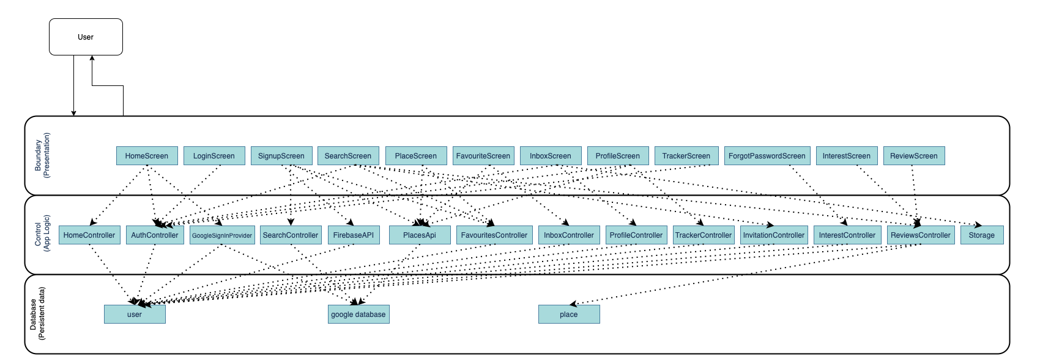
overview of system design
3 layer system architecture
single responsibility principle
to achieve high cohesion, we ensured our classes assumed only 1 responsibility
for example, if invitation class changes, place class need not change
Notes:
This is an brief overview of our system architecture. We adopted a 3 layer system architecture, in which we can see that dependencies flow downward, from our ui classes, to their controllers, to our persistent databases.
One good design principle we used was ensuring that each of our classes assumed only 1 responsibility, in accordance with the single responsibility principle, allowing us to achieve high cohesion and hence, loose coupling in our code

Slide 11
supporting future updates
design principles
following the single responsibility principle and dependency inversion principle means that classes and methods are separated and categorised well
makes it easier to implement/extend additional functionalities
example: adding multiple places to invitation
in the future, may want to make it possible for users to add multiple places to a single invitation sent to friends
can be implemented by simply adding the functionality on to the relevant control classes, without having to modify the existing entity classes.

Slide 12
04
traceability
implementation and testing
Notes:
Thanks ihsan! Ily
Now i’ll talk about how our team ensured traceability throughout our development

Slide 13
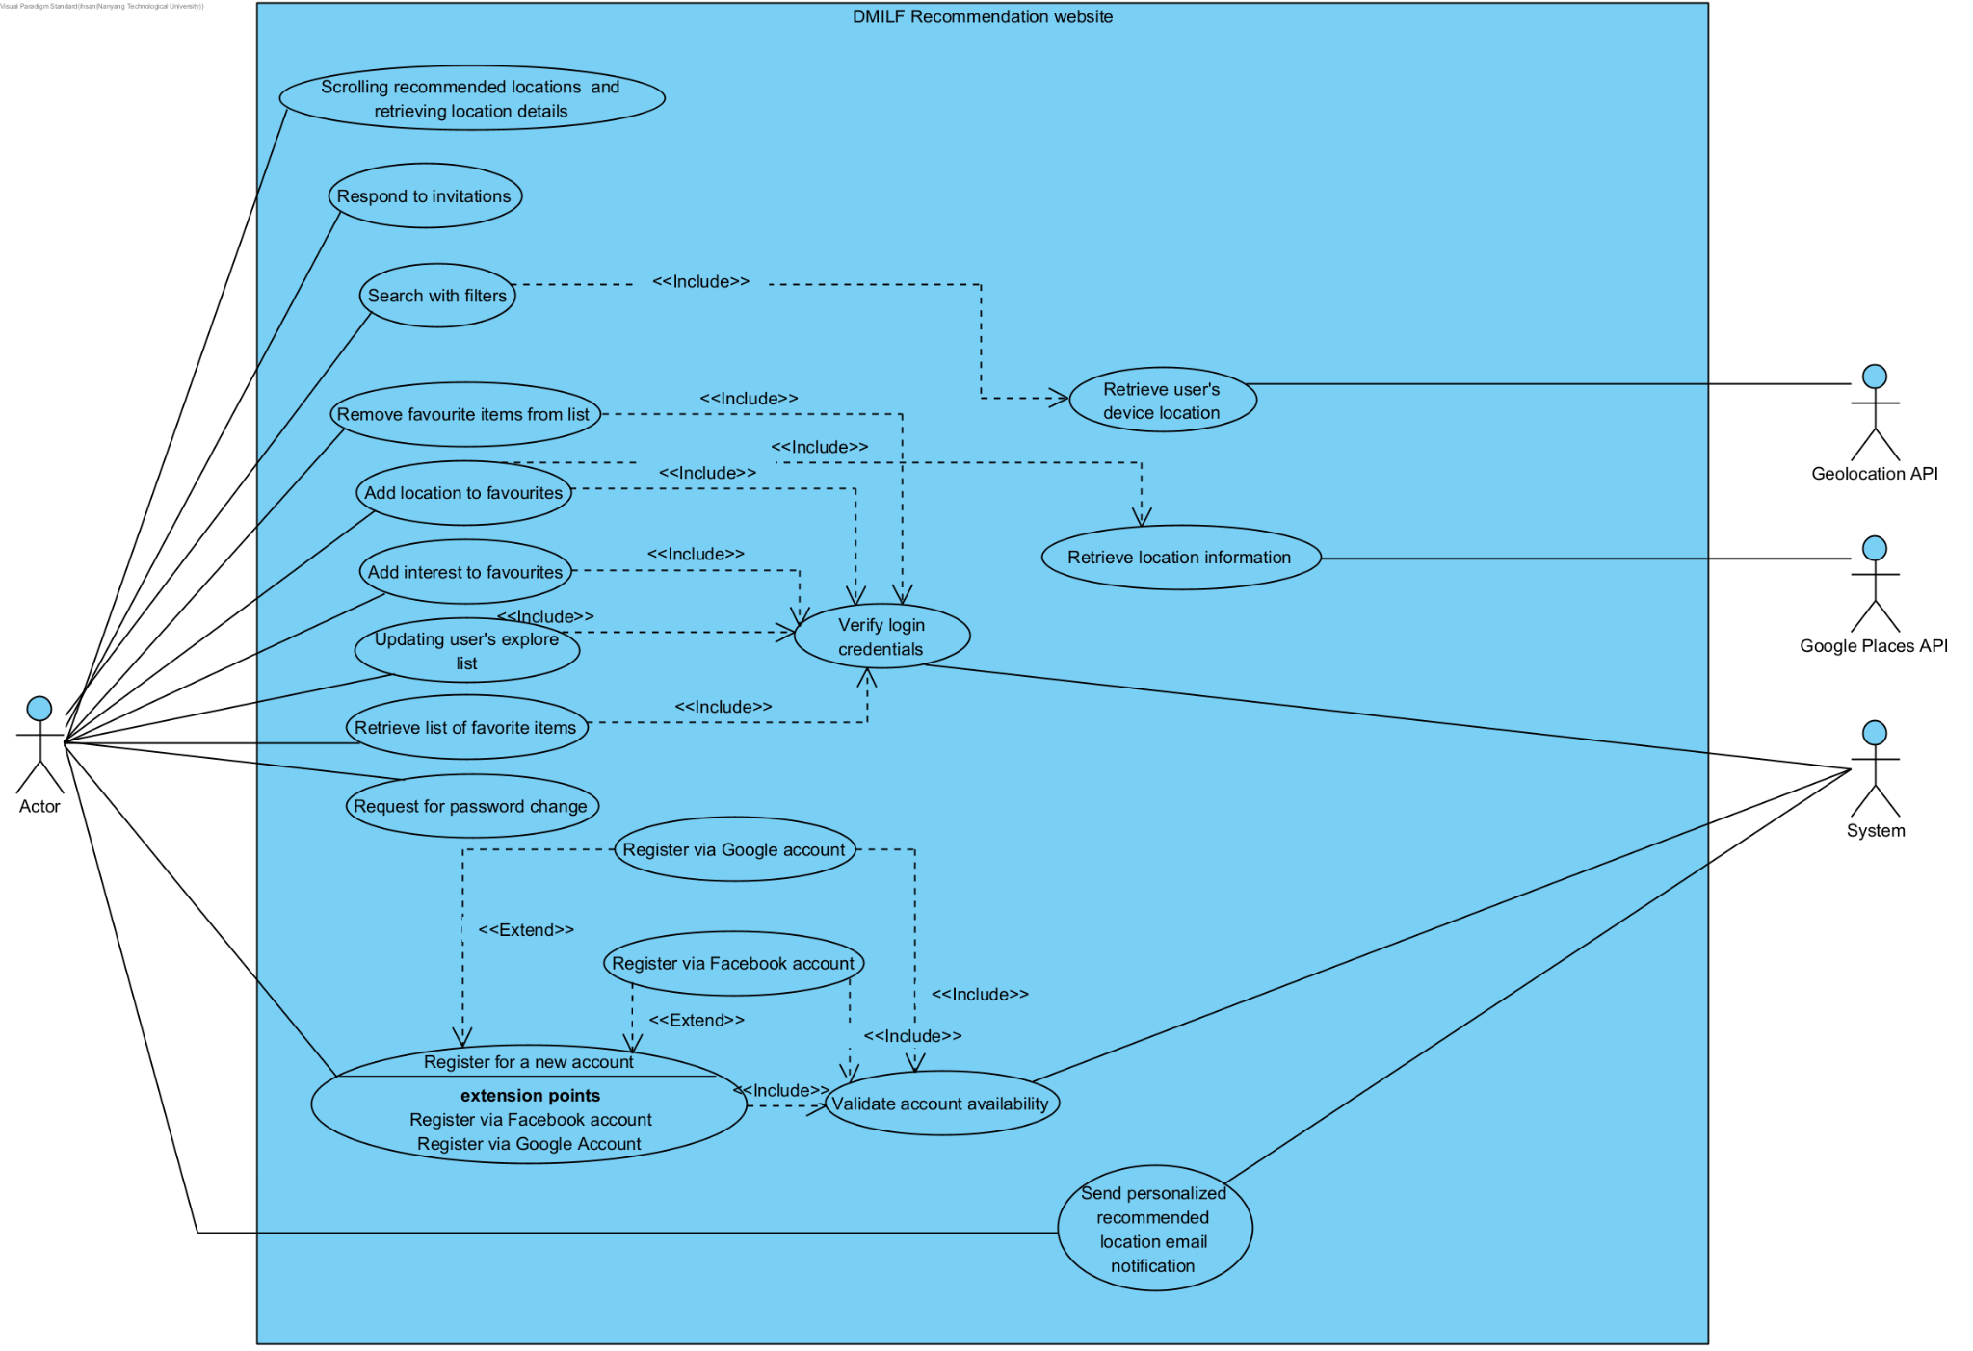
use case diagram
software requirement specification (SRS)
|
|
V
use case diagram
|
|
V
class diagram
|
|
V
sequence diagrams
Notes:
From the very foundations, we elicited our requirements, then generated our use case diagram to further specify the functionalities we wanted to implement in our app.

Slide 14
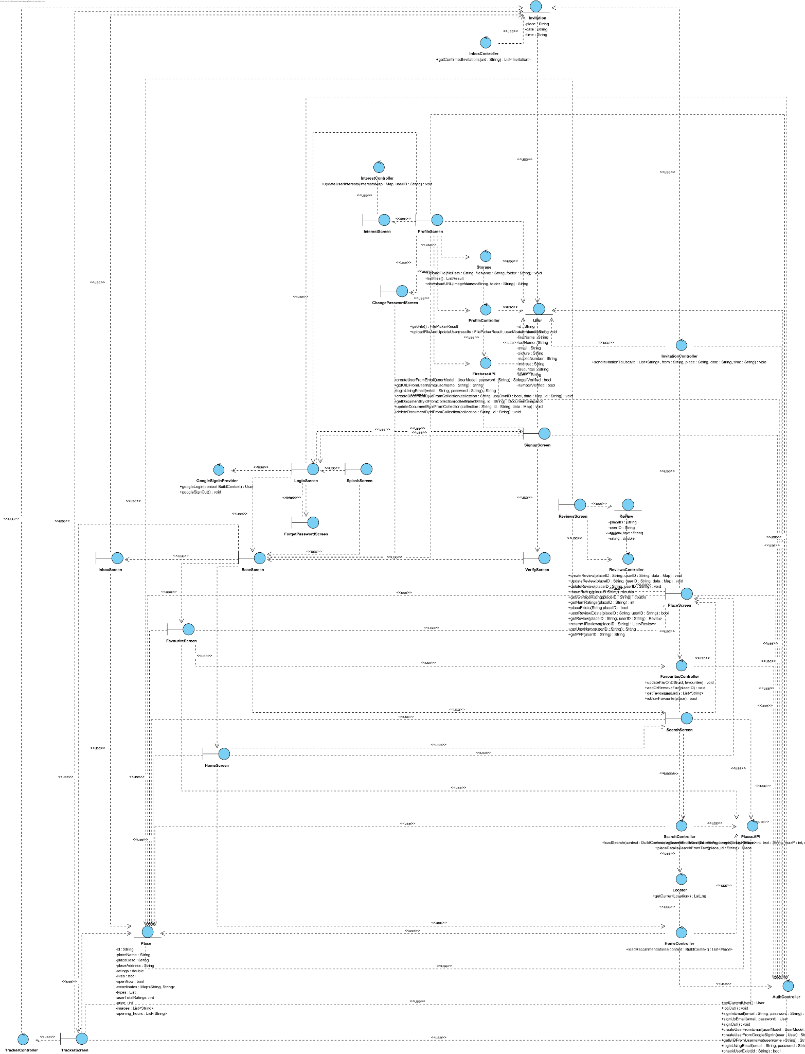
class diagram!
Notes:
From there, we created our very complicated looking class diagram, that aided us in understanding the dependencies between our different classes, that would later allow us to create sequence diagrams of specific functions, guiding us in our design

Slide 15
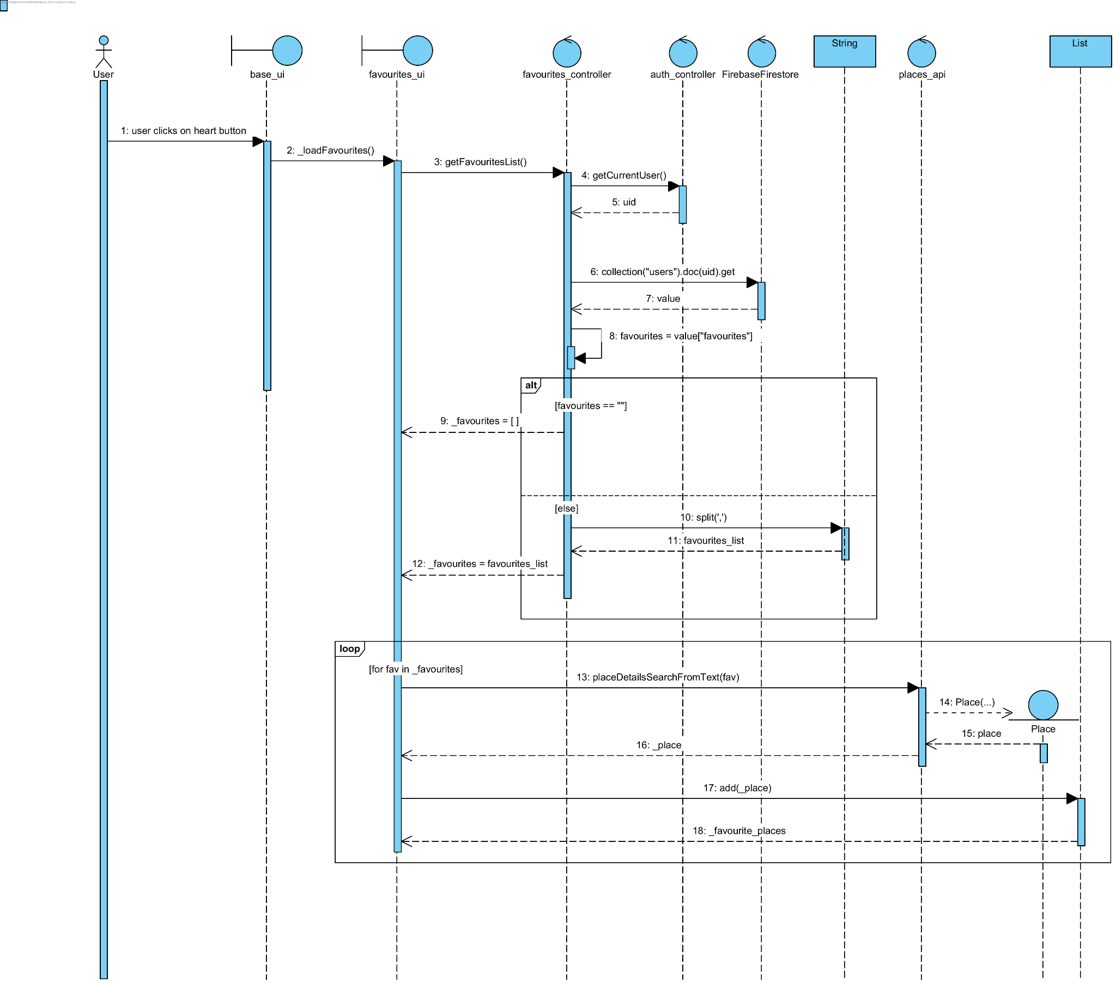
favourite from home page - sequence diagram
user clicks heart button on the home page
Notes:
Our sequence diagrams helped to map out the scenario and sequence of our functions, to ensure that our logic is sound before implementation. To illustrate this point, I’ll briefly talk about our favouriting function’s sequence diagram. On the home page, users can click the heart icon to favourite a place for later viewing.

Slide 16
favourite from home page - sequence diagram
user clicks heart button on the home page
controller classes get the user ID, to retrieve their favourites
Notes:
After clicking the heart, the controller classes are requested to get the current user ID, and use it to retrieve his/her favourites.

Slide 17
favourite from home page - sequence diagram
user clicks heart button on the home page
controller classes get the user ID, to retrieve their favourites
if user has no favourites, an empty list is returned
else, the string of favourited place UIDs returned
Notes:
If the user has no favourites, an empty list is returned. If not, the string of favourited place UIDs are comma separated into a list and returned.

Slide 18
favourite from home page - sequence diagram
user clicks heart button on the home page
controller classes get the user ID, to retrieve their favourites
if user has no favourites, an empty list is returned
else, the string of favourited place UIDs returned
iterate through favourites list
parse each place UID into the places API to fetch place information
which is constructed as a place object
place objects returned and can be viewed in the favourites UI
Notes:
From here, we iterate through this list, parsing each place UID into the places API to fetch the place information. The place information retrieved is constructed into a place object, and a list of these place objects are returned. These place objects can be revisited anytime on the favourites UI, for the user to browse further.

Slide 19
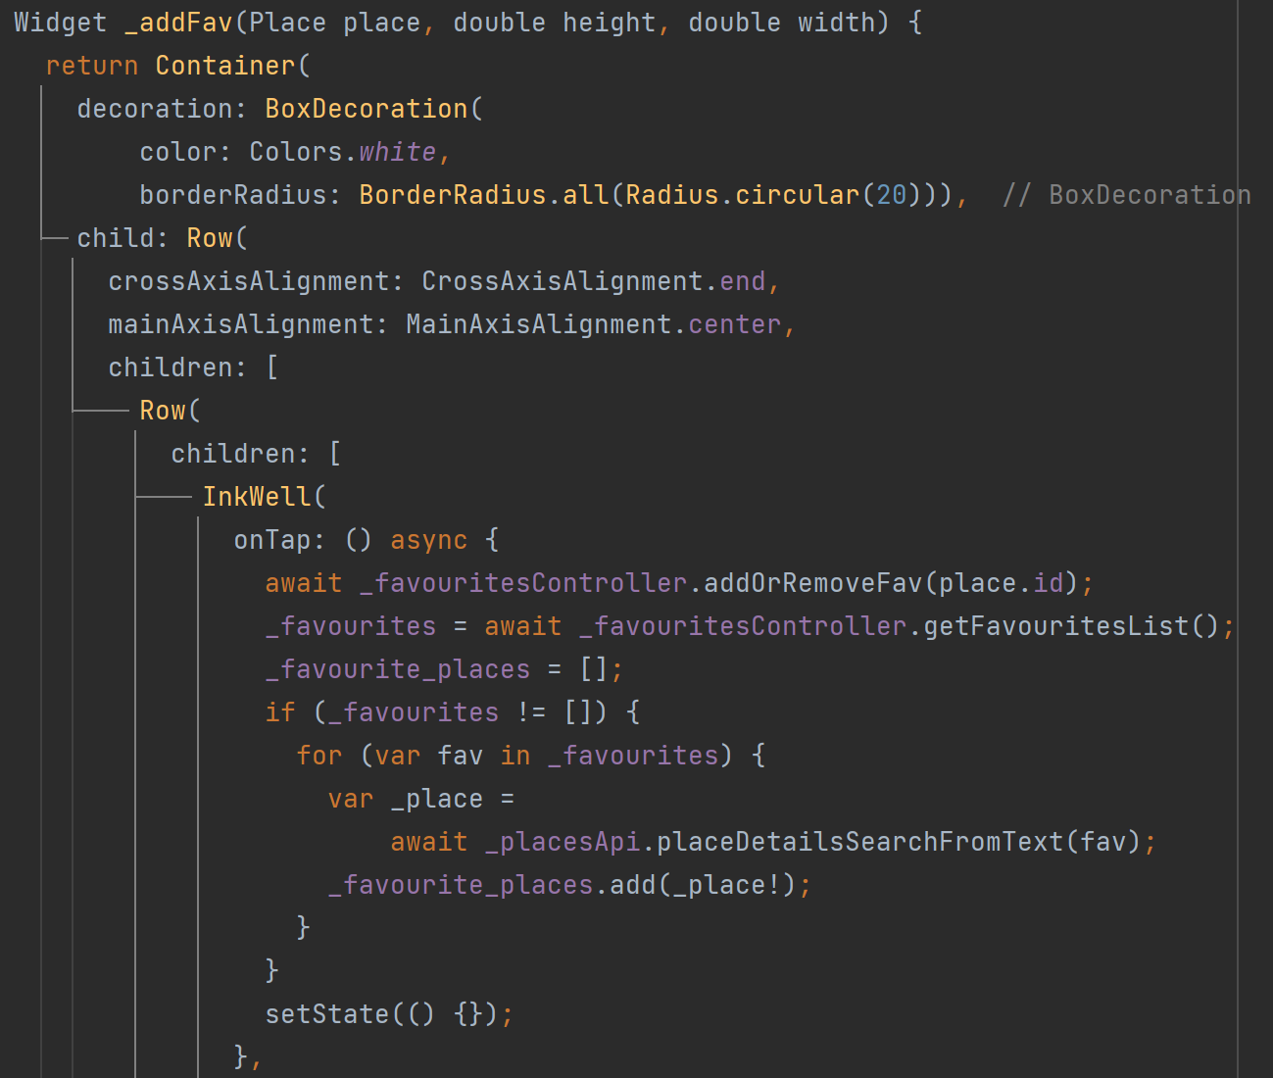
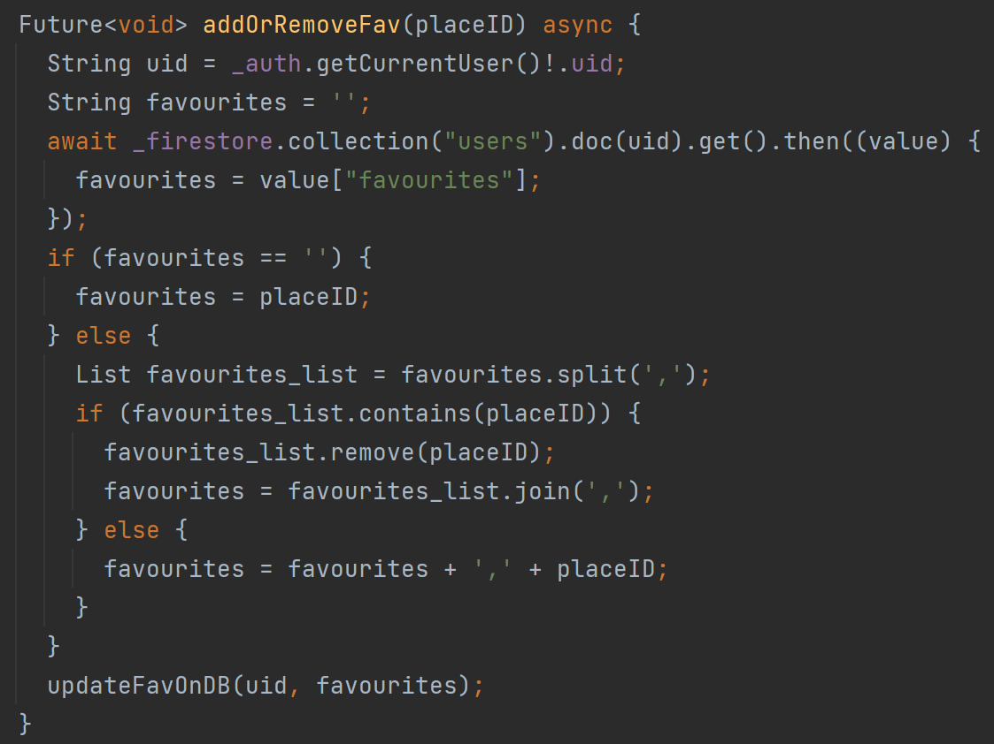
favourite_UI
favourite_controller
separate into boundary for UI and control for app logic
demonstrates high cohesion
eg favourites function is used in several pages such as the favourites UI, tracker UI, and place details UI
Notes:
This is part of the implementation of our add favourites use case. The UI is designed in the FavouritesUI class while logic is implemented in the FavouritesController class. The separation of function from UI demonstrates high cohesion, as the favourite function is used in several pages other than home, such as the favourites, tracker, and place details pages.

Slide 20
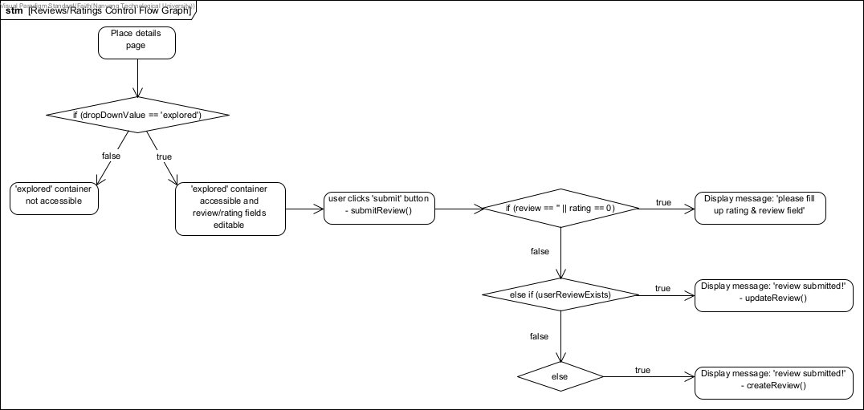
testing - reviews control flow graph
Notes:
After implementation, we did extensive black & white box testing to uncover exceptions in our program. Here I’ll talk about white box testings done for our review function. This is our control flow graph which consists of nodes and decision points which map out the execution flow of the reviewing function. We then used basis path testing to design test cases, to examine all possible paths of execution at least once.

Slide 21
reviews - basis path testing
test input |  |  |  | expected output | actual output
dropDownValue | user review exists? | review != “” | rating != 0
‘explored’ | no | true | true | - review submitted - user’s review created | - review submitted - user’s review created
‘explored’ | yes | true | true | - review submitted - user’s review updated | - review submitted - user’s review updated
‘explored’ | no | false | true | - review not submitted - display error message: ‘please fill up rating & review field’ | - review not submitted - display error message: ‘please fill up rating & review field’
‘explored’ | yes | true | false | - review not submitted - display error message: ‘please fill up rating & review field’ | - review not submitted - display error message: ‘please fill up rating & review field’
‘unexplored’ | no | - | - | review/rating option not available | review/rating option not available
‘to explore’ | no | - | - | review/rating option not available | review/rating option not available
Notes:
Basis path testing generates linearly independent paths. So our base path is that a user hasn’t created a review before, and gives valid review and rating inputs. Generating these paths allows us to cover as much ground as possible while testing, without exploring every single possible input. In this way, we can ensure smooth program flow.

Slide 22
thank you!

